Slide 1
Ebola Project
Polina Brangel, Dr Nadeem Shah, Witness Mchwampaka, Reno Stephens

Slide 2
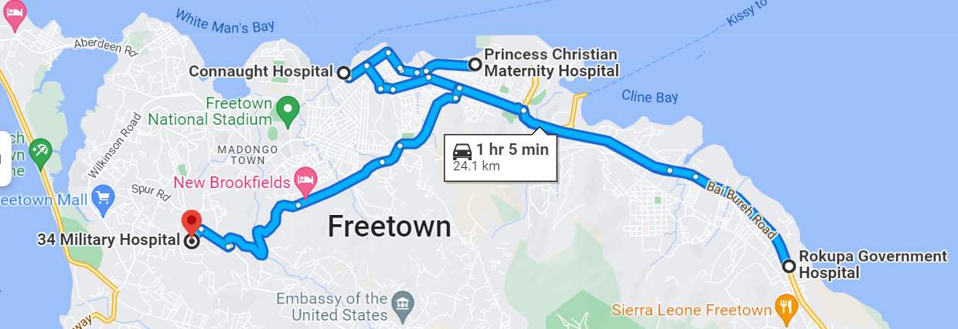
Background Info
Setting: Freetown, Sierra Leone April 2014-June 2015
Population of 1,014,000 in 2014
Intervention introduced September 23, 2014 (Day 170)
Assumption: 70% of all cases sought healthcare; closed SEIR model

Slide 3
Daily Incidence by Hospital
Intervention

Slide 4
Stratified CFR
CFR (total) | 56.56
CRF (F) | 56.58
CRF (M) | 56.53
CRF (Military Hospital) | 56.35
CFR (Princess Christian Maternity Hospital) | 61.23
CFR (Connaught Hospital) | 57.55
CFR (Rokupa Hospital) | 53.91
CRF (funeral) | 52.69
Notes:
Mother to child transmission might explain high CFR at maternity hospital; very little difference across gender; would be useful to also stratify by age group if that data was available

Slide 5
Distribution of the days from symptom onset and hospital admission
Notes:
As the days increase between onset and hospitali, the probability of being admitted into the hospital

Slide 6
Weekly Growth Rate
Notes:
The growth rate over time for the log of cases

Slide 7
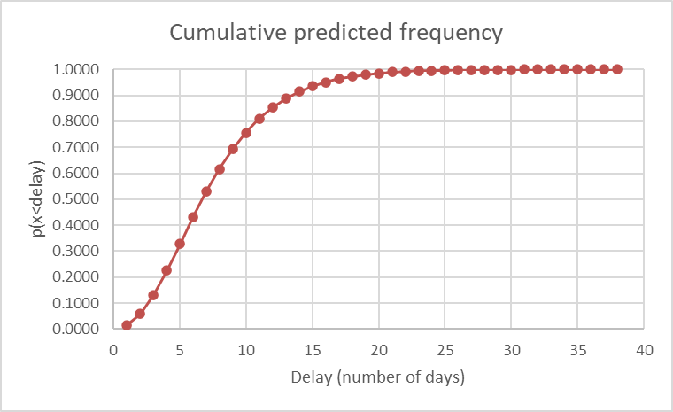
Empirical and Model delays from onset to death
Notes:
This shows that 90% of people with Ebola are dying by ~13 days after symptom onset, which means if you make it beyond that time, your chances of recovery are greater

Slide 8





SEIR model
$γ$ * CFR
I_{d}
$$σ$$
D
$β$ * (I_{d} + I_{r})/N
S
E
I_{r}
R
$γ$ *(1-CFR)
$$α$$
Assumption:
All exposed individuals develop disease with equal rate regardless to the outcome
N – total population of Freetown
Recovered individuals develop immunity to disease

Slide 9
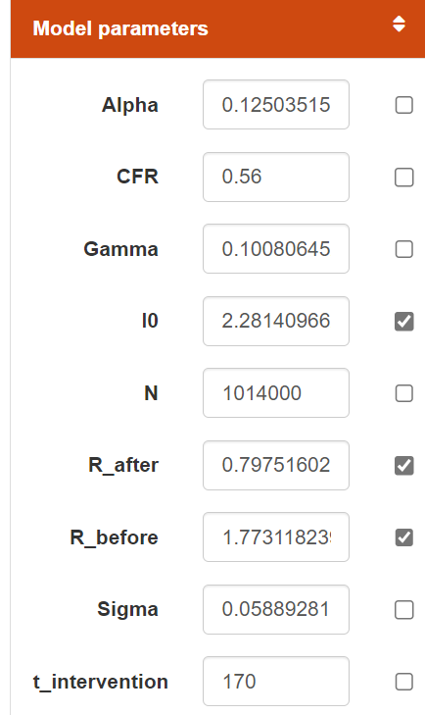
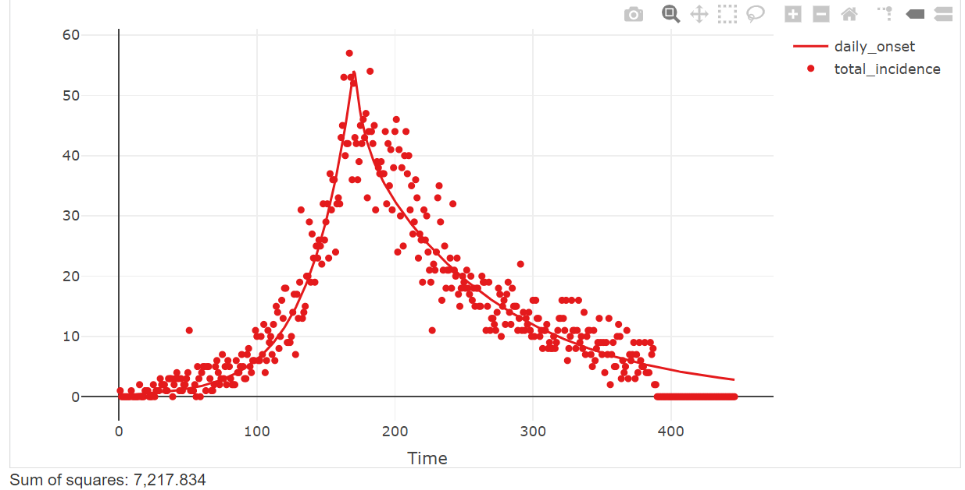
Fitted Model
Notes:
t

Slide 10
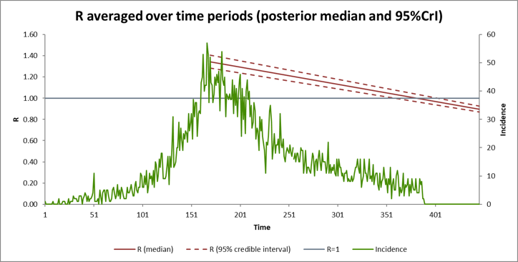
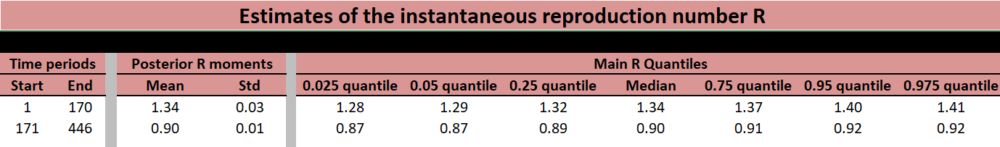
Impact on R before and after intervention

Slide 11
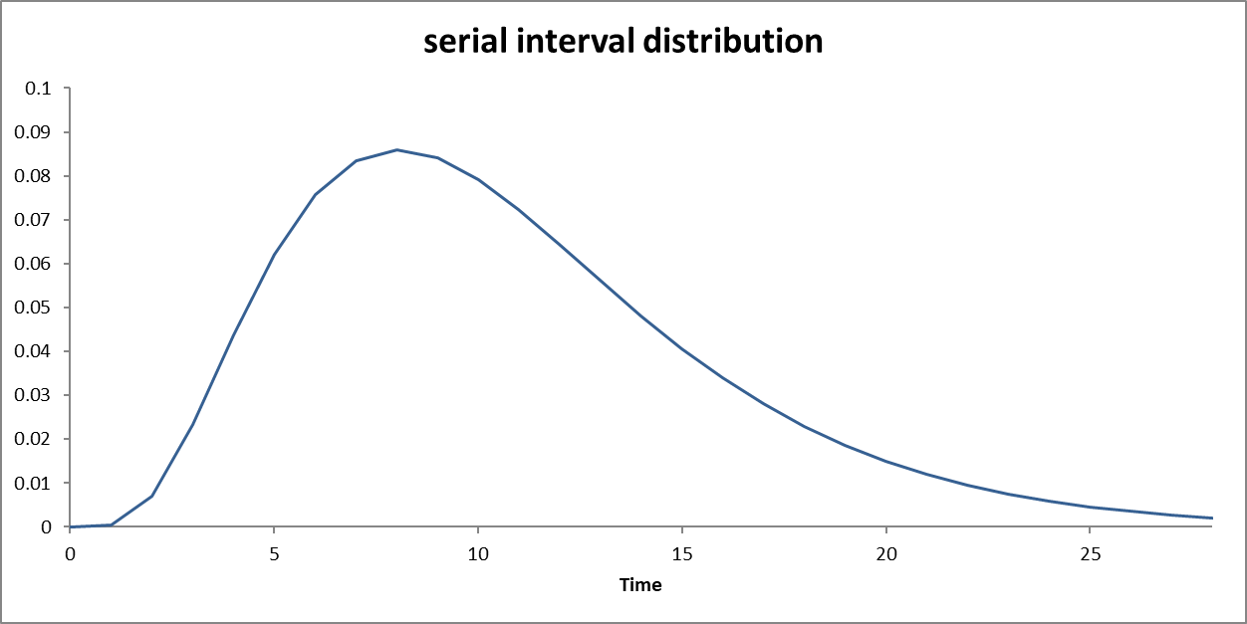

Slide 12
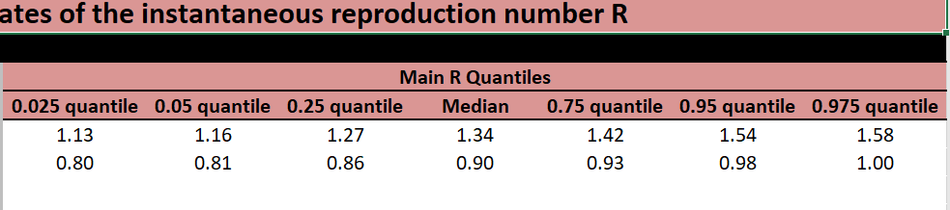
PCMH

Slide 13
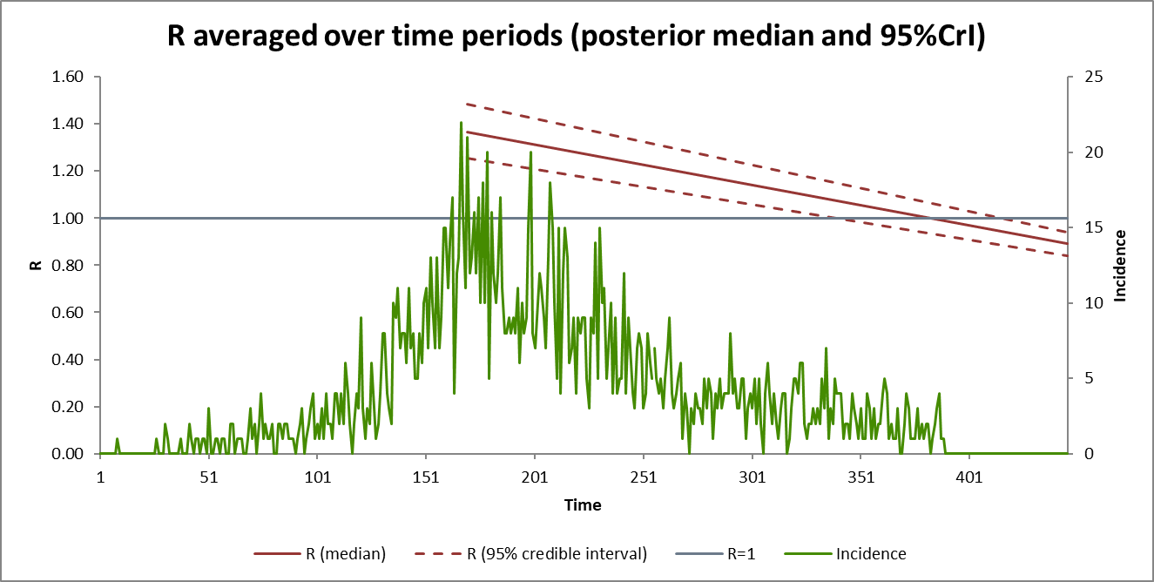
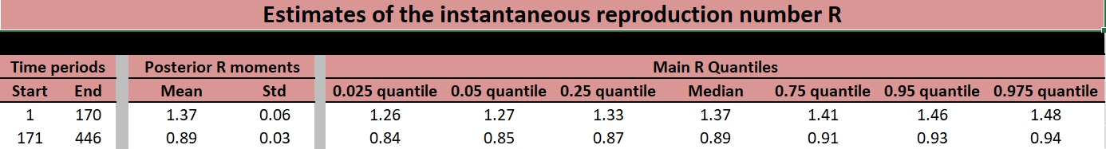
Connaught Hospital
Notes:
The decrease in R0 pre and post intervention is slightly lower for Connaught Hospital compared to PCMH

Slide 14
PCMH

Slide 15
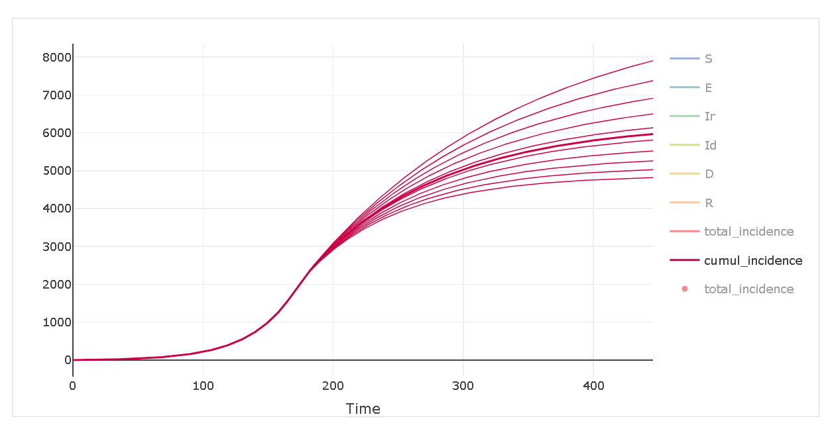
Impact of R_{t} post intervention on total cases
Notes:
Change in reproductive number after introduction of intervention at 170 days to hypothesize and plan for different R0 from the effect of the intervention; implementing intervention at various time points on the effect of Rt

Slide 16
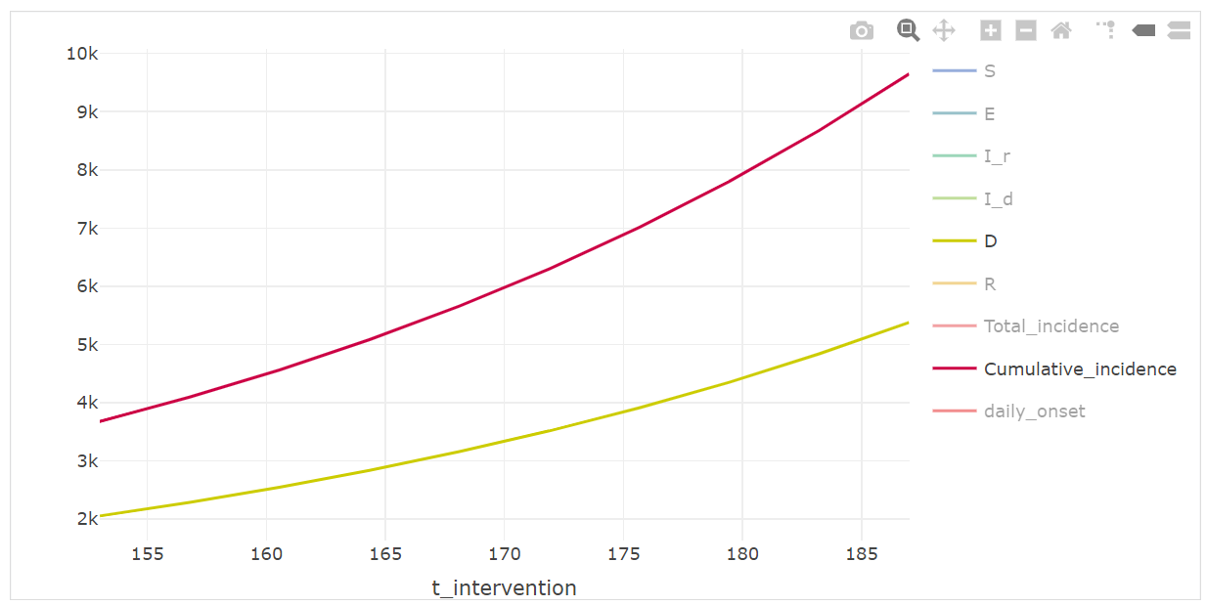
Impact of intervention time on cases and deaths averted
Notes:
By including an intervention at 170 days, we can approximate how many cases and deaths are averted and the impact of having had the intervention implemented weeks earlier or later

Slide 17
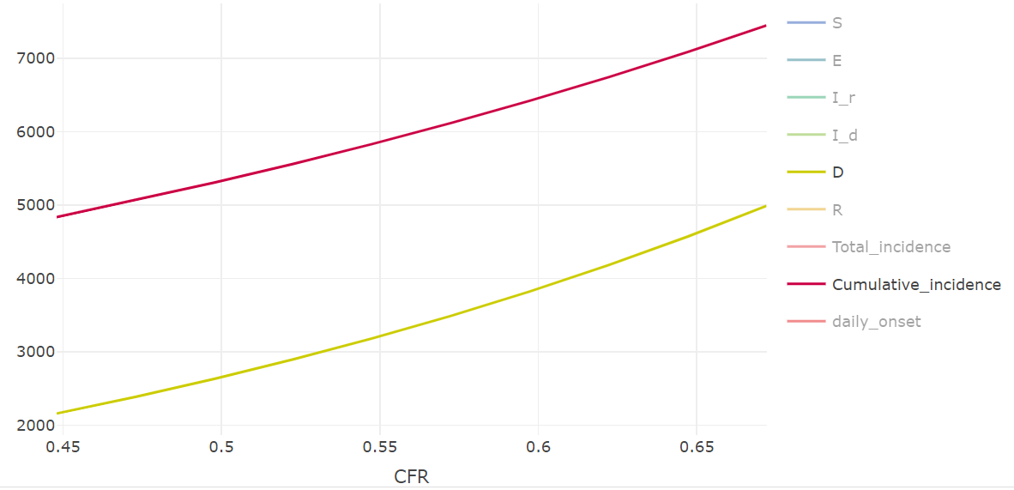
Impact of a pharmaceutical intervention on CFR
Notes:
Impact of a drug intervention for people who have already been infected; CFR is input

Slide 18
Next Steps and conclusions
As the epidemic lasted for over two years it might be useful to include an open model accounting for background birth and death rates for a changing susceptible population
Create additional compartments for hospital vs non-hospital infected cases
Disease severity and death rate depends on age, age stratification would be useful to get a better idea of who is at highest risk
Notes:
We are making assumptions that the time period is

